Slide 1
Real-time alignment and calibration: the RICH systems
22/06/2016 Claire Prouve - University of Bristol LHCb Week
presenting work by Anatoly, Antonis, Chris, Claire, Jibo, Paras and many more

Slide 2
Overview
RICH calibrations
RICH mirror alignment
Procedure
Improvements during Run II
Results

Slide 3
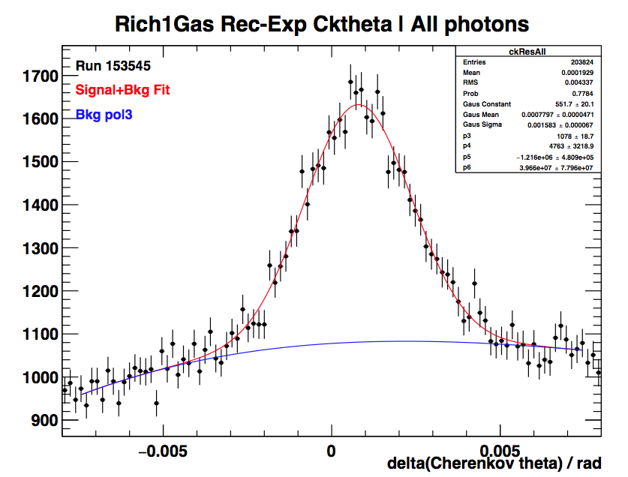
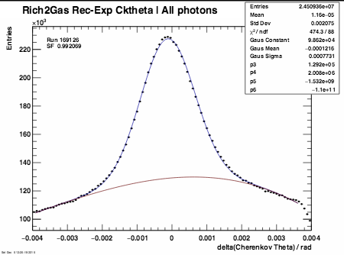
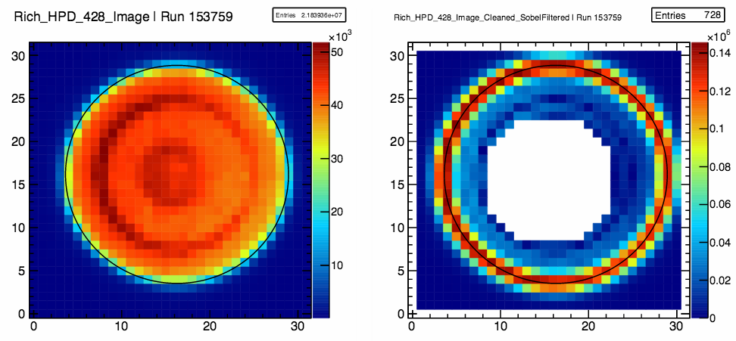
RICH calibrations
Refractive index calibration:
Hardware sensors monitor pressure and temperature.
Limited precision and does not account for gas mixture changes.
Simple fit to reconstructed-expected Cherenkov angle yields (n-1) scale factor.
HPD image calibration:
Image fit performed for each HPD and used to provide calibration for the anode element.
Fully automatically for every run since beginning of Run II.
Sobel Filter

Slide 4
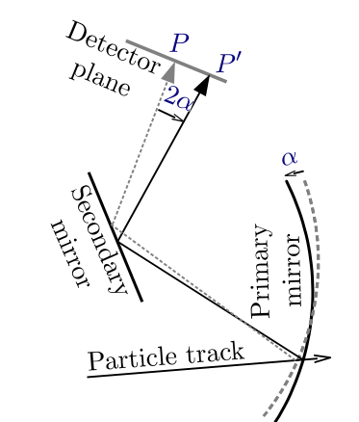
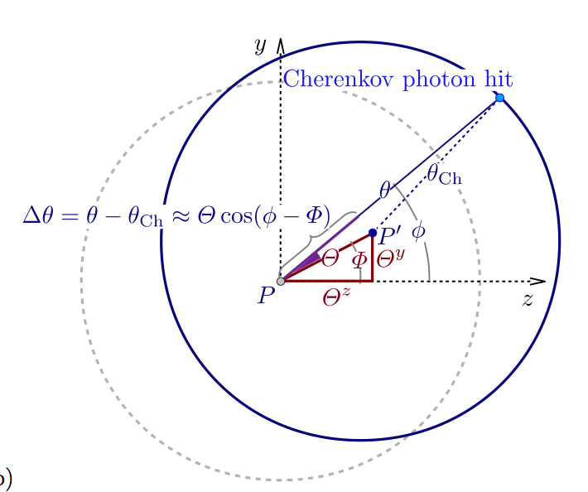
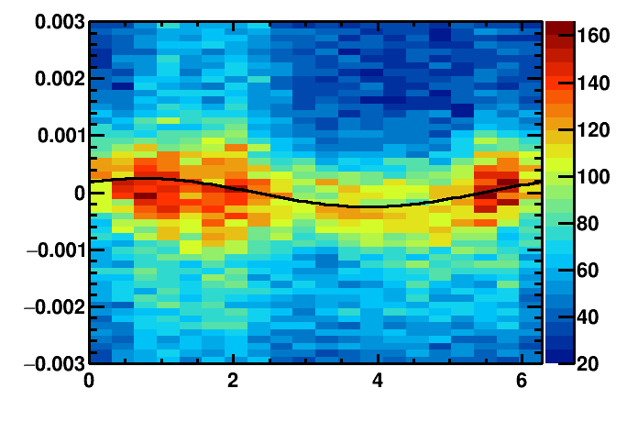
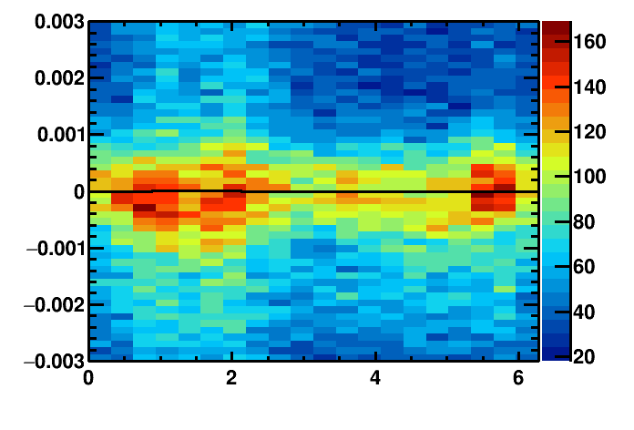
RICH mirror alignment
Detector plane
Identify misalignment:
Misalignment
Δθ_{C}(Φ) = θ_{meas.}- θ_{exp.}
Δθ_{C}(Φ) = Θ^{y}_{p,s} cos(Φ) + Θ^{z}_{p,s} sin(Φ)
Proj. Track position
Real track position
Misalignments on detector plane
Misaligned mirror:
Aligned mirror:
Cherenkov angle resolution / rad
Cherenkov angle resolution / rad
azimuthal angle/ rad
azimuthal angle/ rad

Slide 5
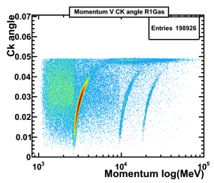

Mirror alignment procedure
Select high momentum tracks + reconstruct under pion- hypothesis.
Fill histograms with (Δθ vs. Φ) of unambiguous photons for each mirror com- bination.
Events
database
Replace database and perform another iteration.
Alignment
converged!
NO
YES
Produce new database and verify if the convergence criteria was met.
Fit misalignment on the detector plane and determine individual mirror misalignments.

Slide 6
Development during Run II
 | Reco. | Mode | Improvements | Time per alignment
Run I | Ganga | manually |  | Several days
Run II | HLT farm | manually | Migrated to online Dedicated HLT1 lines | ~4 hours
Run II end of 2015 | HLT farm | manually | Using pre-calculated magnification coefficients Improved method for fitting 2D histograms | ~20 minutes
Run II beginning of 2016 | HLT farm | automatic for every fill | L2 regularization method for finding individual mirror tilts New CondDB | ~10 minutes after mag. flip: ~30 minutes for RICH1
Run II end of June 2016 | HLT farm | automatic for every fill | Different convergence criteria for primary/secondary mirrors in y/z Calculation of difference between final alignment and alignment in CondDB | ~10 minutes for each RICH detector

Slide 7
Stability of tilts – RICH1
Mag Down
Mag Up
Convergence criteria
0.1 mrad

Slide 8
Stability of tilts – RICH2
Convergence criteria
0.1 mrad

Slide 9
Stability of Resolution
Resolutions from refractive index calibration (without HPD image correction).
magnet down
magnet up
magnet down before new DB

Slide 10
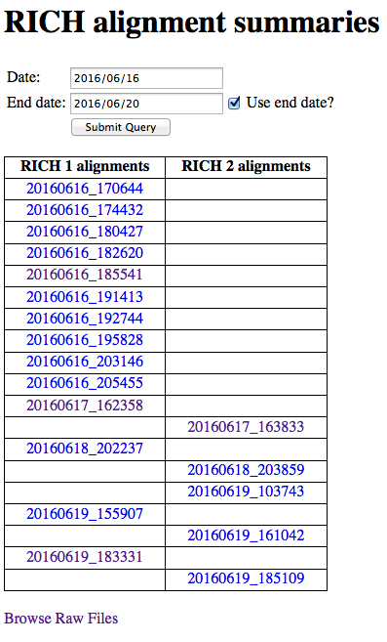
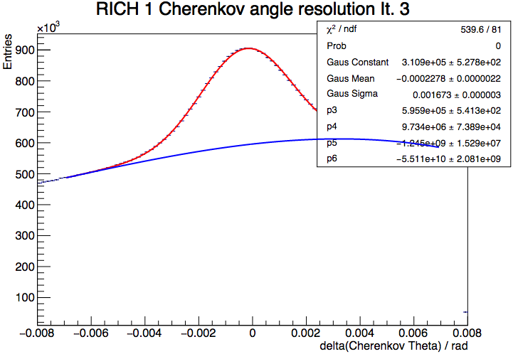
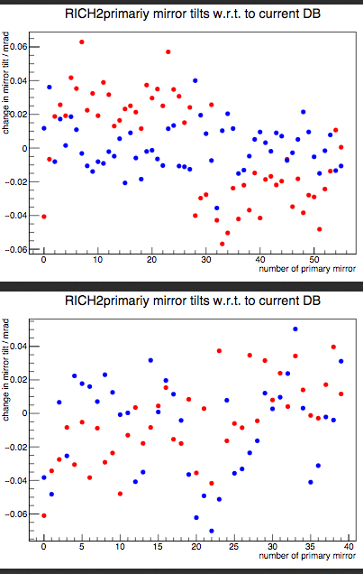
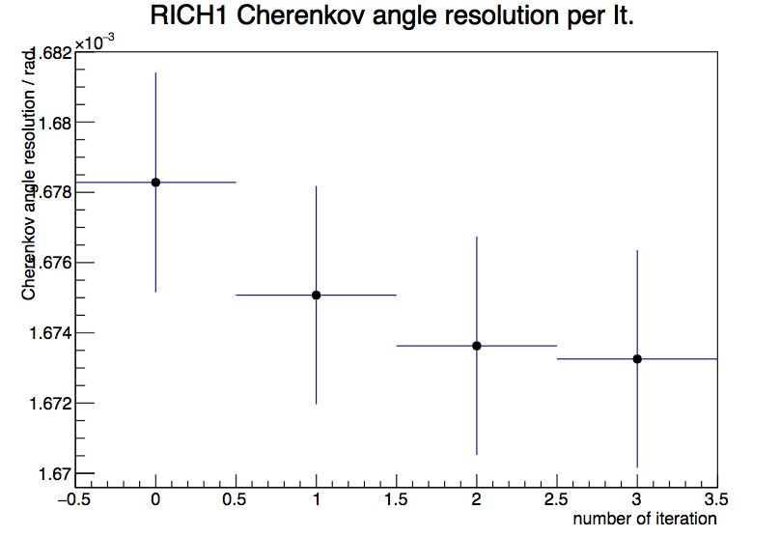
Current monitoring
https://lbgroups.cern.ch/rich/calibview.php
https://lbgroups.cern.ch/rich/alignmentview.php
RICH2 primary mirror tilts w.r.t. CondDB
Tilts in y
Tilts in z
RICH2 secondary mirror tilts w.r.t. CondDB
number of secondary mirror

Slide 11
Summary
RICH calibrations run online for every run
RICH mirror alignment runs online for every fill
Several improvements in stability and speed
Information from frequently run alignments to understand and make improvements
Monitoring plots for the RICH piquet

Slide 12
Backup

Slide 13
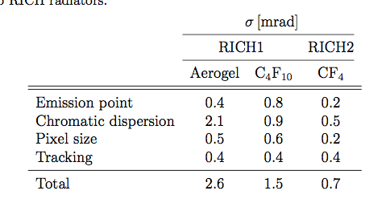
Cherenkov angle resolution
Limiting factors to Cherenkov angle resolution:

Slide 14
Fit to 2D histograms
Misaligned mirrors:
Aligned mirrors:
Δθ [rad]
Δθ [rad]
Φ [rad]
Φ [rad]
Signal:
Gaussian
BKG:
2nd order polynomial
Means of Gaussians connected by:
Δθ_{C}(Φ) = Θ^{y}_{p,s} cos(Φ) + Θ^{z}_{p,s} sin(Φ)
14

Slide 15



Magnification coefficients
Magnification coefficients: Translate the tilt on the detector plane into actual mirror tilts
Magnification coefficients are calculated new for each iteration:
Introduce 8 rotations: primary and secondary mirrors rotated around ±y and ±z axis respectively
Rotate about 0.3 mrad ( half the resolution of RICH2)
Reconstruct events for each rotation and evaluate the tilts on the detector plane
Need to reconstruct all events 9 times!
Misalignments on detector plane
Mirror tilts

Slide 16
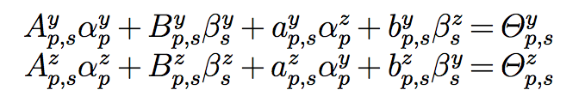
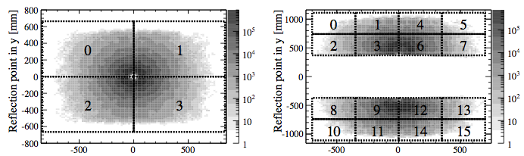
Disentangling mirror-pairs
Each pair of primary mirror p and secondary mirror s has 2 equations:
Δθ_{C}(Φ) = Θ^{y}_{p,s} cos(Φ) + Θ^{z}_{p,s} sin(Φ)
Magnification factors individual mirror tilts
Challenge: not enough information to fully constrain the solution
sss
RICH1: 8 equations for 10 unknowns aaa
Rotation of primary mirrors followed by according rotation of secondary mirrors yields same results s
➔ Need additional constraint
RICH1 primary mirrors
RICH1 secondary mirrors

Slide 17
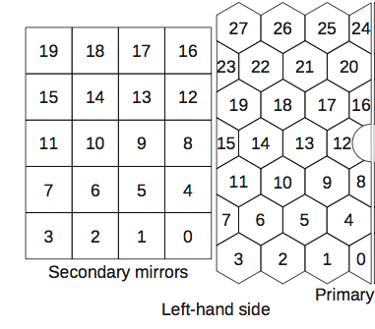
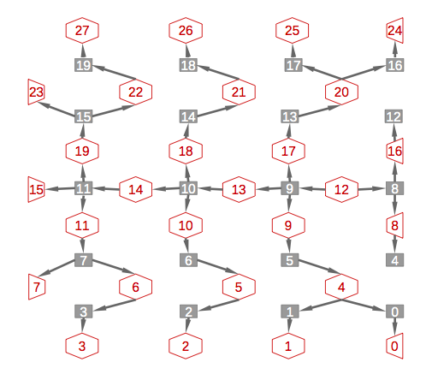
Disentangling – until 2016
Primary mirrors
Secondary mirrors
RICH1:
fix primary mirrors, align secondary mirrors
RICH2:
Left half: system of equations linking all mirrors starting from primary mirror 12.
Andrew Cook
primary mirrors, secondary mirrors
17

Slide 18


Disentangling – from 2016
L2 regularization (ridge regression): d
rewrite problem as
Minimize: least square method L2 regularization term
Advantages:
more stable than the previous method
Stable w.r.t. small statistical fluctuations (unlike L1 regularization)
➔ Fewer iterations needed to converge
Vector of results of fit to histograms
Matrix of
magnification factors
Vector of individual mirror tilts

Slide 19
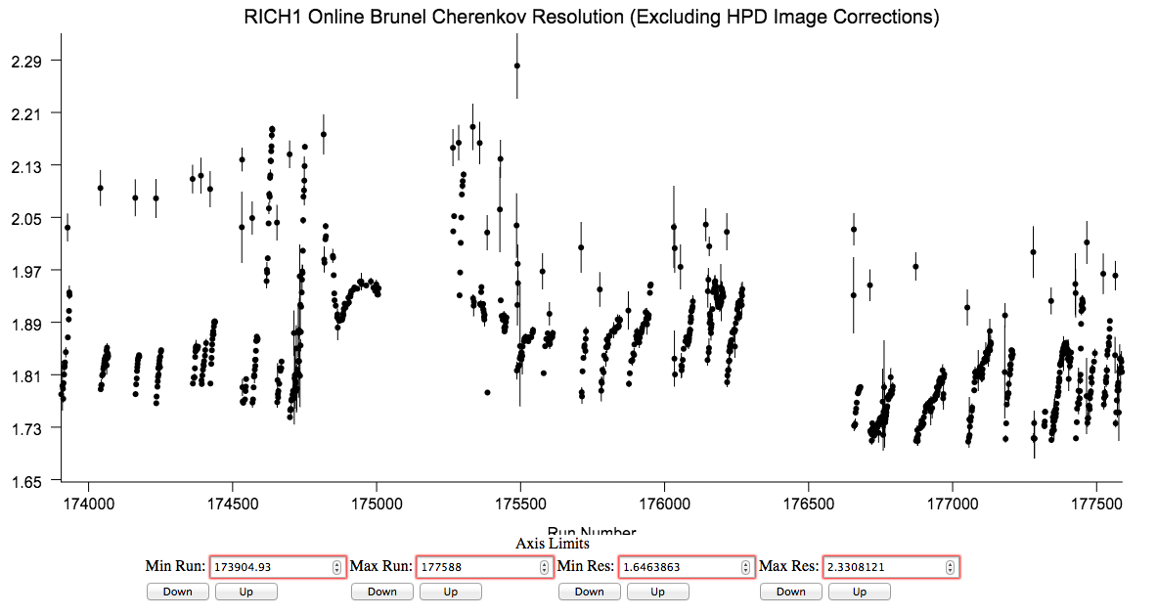
Resolution
Without HPD image correction: Degradation of resolution over fill.
➔ Longer fills in 2016
magnet down
magnet up
magnet down before new DB

Slide 20
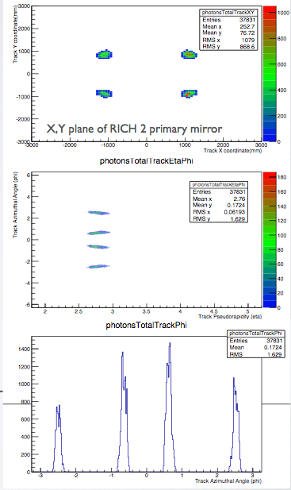
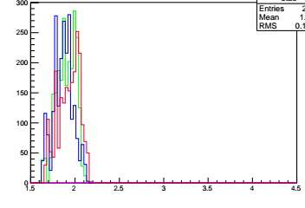
New HLT Lines
Trigger on tracks that will populate the hardest-to-populate mirror-pairs
usually the very outer mirrors
Other tracks in the events will populate the rest
RICH2
Track azimuthal angle / rad
RICH2 line:
p > 40 GeV && χ² < 2 && 2.65 < η < 2.80
(-2.59 < Φ < -2.49) || ( -0.65 < Φ < -0.55) || (0.45 < Φ < 0.65) || (2.49 < Φ < 2.59)
Track pseudorapidity
RICH1
RICH1 line:
p > 10 GeV && χ² < 2 && 1.6 < η < 2.04
(-2.65 < Φ < -2.3) || (-0.8 < Φ < -0.5) || (0.5 < Φ < 0.8) || (2.3 < Φ < 2.65)
Need to reconstruct ~10 times less events!
Track pseudorapidity

